Slide 1


FORMATTING A WEBPAGE
BY PROBIR SIR

Slide 2
TOPICS TO BE COVERED
INTRODUCTION
TEXT PROPERTIES
BACKGROUND PROPERTIES
FONT PROPERTIES
MARGIN PROPERTIES
CONCLUSION

Slide 3
INTRODUCTION
HTML 5 provides different methods to format text on a webpage and makes it more easier to change the style of an individual tag.
Cascading Style Sheet is a more useful way to style the elements or tags of a webpage.
CSS controls various elements like color, font, text size etc. of any tag in html.
By using external CSS we can use a style sheet as a template to design our webpages.
We can store all the information in one place and change the required appearance on a single CSS file to make it effective in multiple html files.

Slide 4
Text Properties
Text properties are used to change the appearance of the text.
Property | Value | Description
Color | Red, blue, green, Yellow, black, White | Specifies the text color on the webpage.
Text-align | Left, center, right, justify | Specifies the alignment of text.
Text-indent | Length in pixels or percentage | Specifies the indentation of the first line of the text.
Text-decoration | Underline, overline or strikethrough | Specifies the text effects like underline, overline or strikethrough.
Text-Transform | Capitalise, Uppercase, Lowercase and none | Specifies the uppercase, lowercase or title case of text given into a webpage.

Slide 5
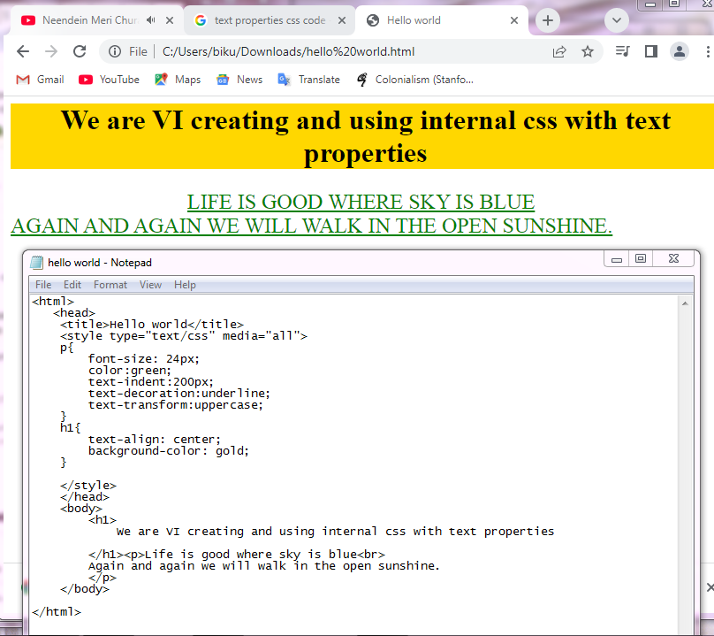
Codes are written to implement internal CSS with text properties

Slide 6
Background Properties
The background properties are used to change the appearance of the background in html element.
Property | Value | Description
Background-color | Red, blue, green, Yellow, black, White | Specifies the background color to be used on the webpage.
Background-image | URL of the image | Specifies the image to be used in the background of webpages.
Background-repeat | Repeat, repeat-x, repeat-y, (Here x-horizontal and y-vertical), no repeat | Specifies the repetition of an image on the webpage.

Slide 7
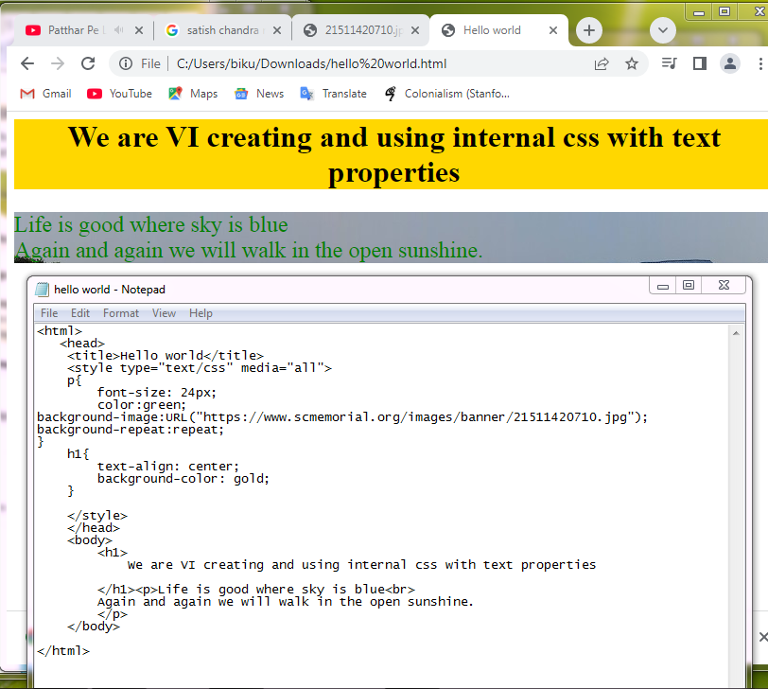
Codes are written to implement internal CSS with background- properties

Slide 8
Font Properties
The font properties are used to change the font family, font size, and font style of the text.
Property | Value | Description
Font-family | Times New Roman, Verdana, Arial etc. | Specifies the font to be used.
Font-size | Value is given in pixels. Default size 16 px. Em is also used, when 1em = 16px. Also percentage can be used. | Specifies the font size used on the webpage.
Font-style | Normal, italics | Specifies the style of the font.

Slide 9
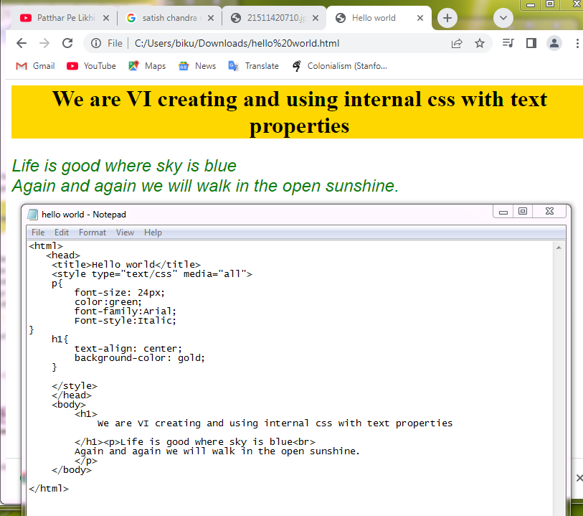
Codes are written to implement internal CSS with font properties

Slide 10
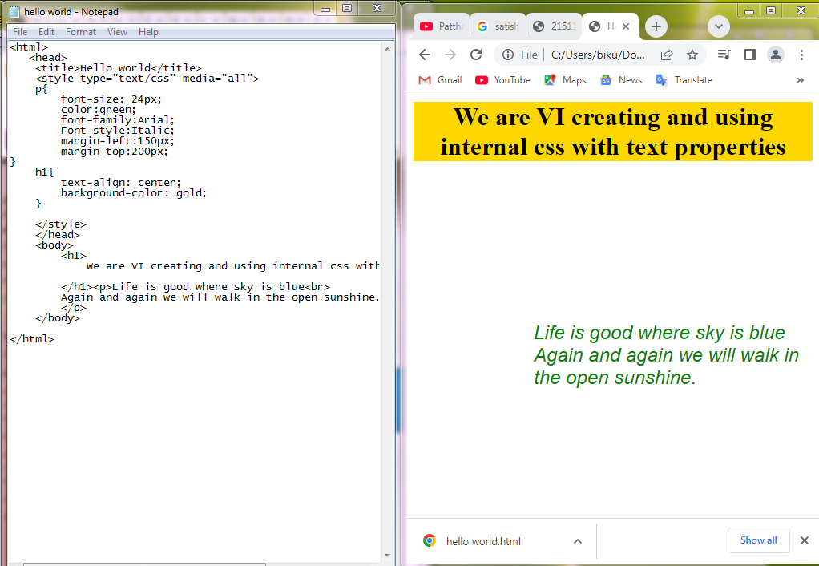
Margin Properties
Margin is the space that appears around the elements.
To set margin of an element we use the margin property.
The four sides of the margins are: - 1. Top, 2. Bottom, 3. Left, 4. Right.

Slide 11

Conclusion
Formatting an HTML5 file is always a nice to create a beautiful webpage.
We use CSS3 to format an HTML 5 document.
Full form of CSS is Cascading Style Sheet. Present version is 3.

